Slide 1
COMPLICATIONS OF DIABETES
GROUP 1

Slide 2
GROUP MEMBERS
AGBEKA LESLEY OBAKORE
ILIYA FAVOUR FENHAS
AFOLABI PRECIOUS INIOLUWA
OLUSEGUN IFEOLUWA JESSICA
ABIROH ANITA
ADENUGHAR CYNTHIA
AGHASILI VIVIAN CHIDINMA
AKAH CHINEMEREM
NWAFOR JACHIMMA
OFOKANSI FAVOUR
OHWAVWORHUA EMMANUELLA
OKPAKO LOVETH
ONUAGULUCHI FAVOUR

Slide 3
GROUP MEMBERS
ANYA-FRANCES FAVOUR
BOBMANUEL EMMANUELLA
ENEDU HAPPINESS IFUNANYA
IGOCHUKWU-DIMM JANE
KOLA-OYEGOKE OLUWABUNMI ELIZABETH
OYEBADE OMOTOLANI
SELEKEODUDU FAVOUR
BARNABAS DURAN
ADEMESO OYINDAMOLA ELIZABETH
WILLIAMS EMMANUEL

Slide 4
TABLE OF CONTENTS
INTRODUCTION
TYPES OF DIABETES
BLOOD SUGAR LEVEL CHARTS
COMPLICATIONS OF DIABETES
MANAGEMENT OF COMPLICATIONS OF DIABETES
REFERENCES

Slide 5
INTRODUCTION
Diabetes is a chronic medical condition that affects the way the body metabolizes glucose. Over time, high blood glucose levels can lead to a range of complications. It is a chronic condition that affects how your body turns food into energy. It can cause high blood sugar levels and serious health problems, such as heart disease, kidney failure, blindness and amputation.

Slide 6
TYPES OF DIABETES
There are three main types of diabetes:
Type 1 diabetes (also known as juvenile or insulin dependent) is caused by an autoimmune reaction that stops your body from making insulin.
Type 2 diabetes is when your body doesn't use insulin well and can't keep blood sugar at normal levels.
Gestational diabetes is when pregnant women have high blood sugar levels that can affect their baby's health. Diabetes can be managed with medication, diet, exercise and regular check-ups .

Slide 7
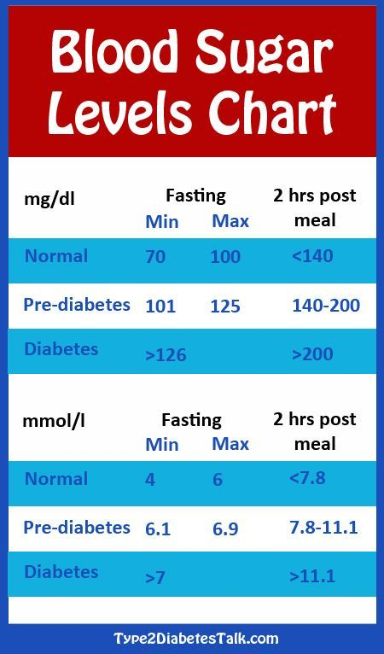

Slide 8
COMPLICATIONS OF DIABETES
DIABETIC NEUROPATHY
Diabetic neuropathy is a type of nerve damage that can occur if you have diabetes. High blood sugar (glucose) can injure nerves throughout the body. Diabetic neuropathy most often damages nerves in the legs and feet. Depending on the affected nerves, diabetic neuropathy symptoms include pain and numbness in the legs, feet and hands. It can also cause problems with the digestive system, urinary tract, blood vessels and heart. Some people have mild symptoms. But for others, diabetic neuropathy can be quite painful and disabling.

Slide 9
TYPES OF DIABETIC NEUROPATHY
THERE ARE 4 MAIN TYPES OF DIABETIC NEUROPATHY
Peripheral neuropathy
Autonomic neuropathy
Proximal neuropathy (diabetic polyradiculopathy)
Mononeuropathy (focal neuropathy)

Slide 10
PERIPHERAL NEUROPATHY
This type of neuropathy may also be called distal symmetric peripheral neuropathy or sensory neuropathy. It's the most common type of diabetic neuropathy. It affects the feet and legs first, followed by the hands and arms. Signs and symptoms of peripheral neuropathy are often worse at night, and may include:
Numbness or reduced ability to feel pain or temperature changes

Slide 11
PERIPHERAL NEUROPATHY
Tingling or burning feeling
Sharp pains or cramps
Muscle weakness
Extreme sensitivity to touch — for some people, even a bedsheet's weight can be painful
Serious foot problems, such as ulcers, infections, and bone and joint damage

Slide 12
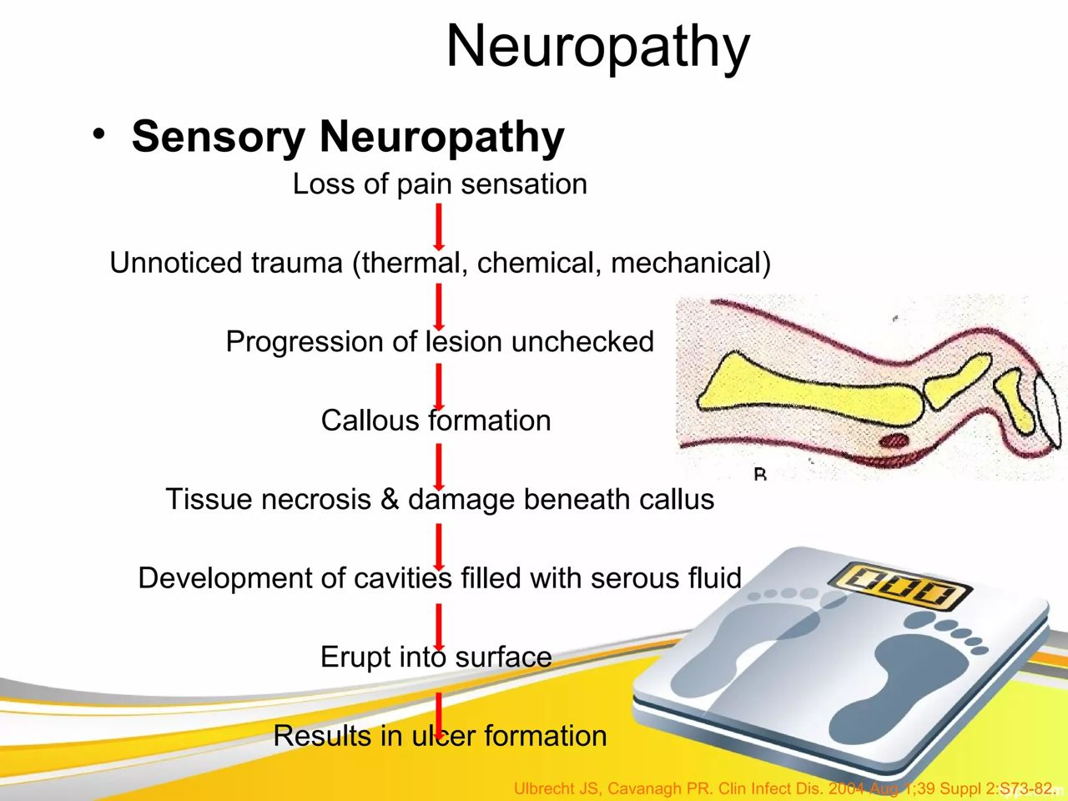

Slide 13
AUTONOMIC NEUROPATHY
The autonomic nervous system controls blood pressure, heart rate, sweating, eyes, bladder, digestive system and sex organs. Diabetes can affect nerves in any of these areas, possibly causing signs and symptoms including:
A lack of awareness that blood sugar levels are low (hypoglycemia unawareness)Drops in blood pressure when rising from sitting or lying down that may cause dizziness or fainting (orthostatic hypotension)Bladder or bowel problems

Slide 14
AUTONOMIC NEUROPATHY
Slow stomach emptying (gastroparesis), causing nausea, vomiting, sensation of fullness and loss of appetite
Difficulty swallowing
Changes in the way the eyes adjust from light to dark or far to near
Increased or decreased sweating
Problems with sexual response, such as vaginal dryness in women and erectile dysfunction in men

Slide 15
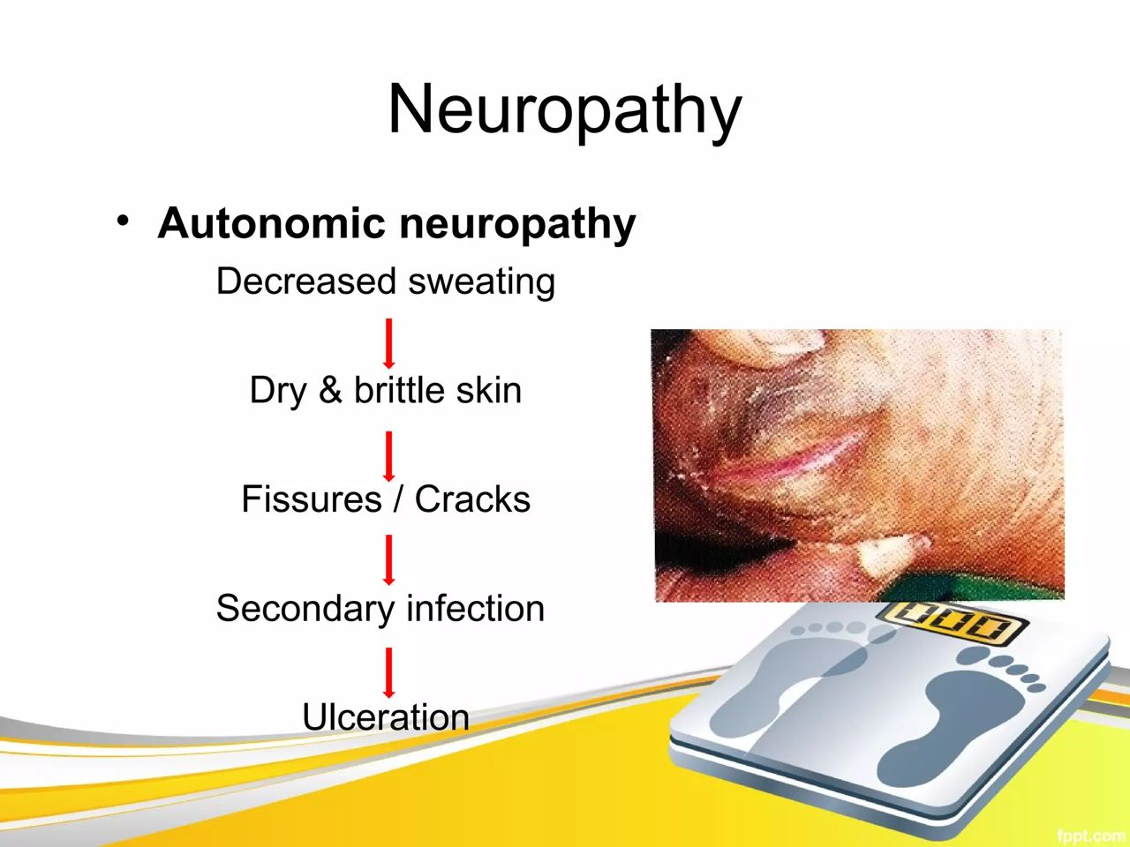

Slide 16
PROXIMAL NEUROPATHY (DIABETIC POLYRADICULOPATHY)
This type of neuropathy often affects nerves in the thighs, hips, buttocks or legs. It can also affect the abdominal and chest area. Symptoms are usually on one side of the body, but may spread to the other side. Proximal neuropathy may include:
Severe pain in the buttock, hip or thigh
Weak and shrinking thigh muscles
Difficulty rising from a sitting position
Chest or abdominal wall pain

Slide 17
MONONEUROPATHY (FOCAL NEUROPATHY)
Mononeuropathy refers to damage to a single, specific nerve. The nerve may be in the face, torso, arm or leg. Mononeuropathy may lead to:
Difficulty focusing or double vision
Paralysis on one side of the face
Numbness or tingling in the hand or fingers
Weakness in the hand that may result in dropping things
Pain in the shin or foot

Slide 18
DIABETIC FOOT ULCER
Diabetic ulcers on the foot are sores formed below the ankle as a result of a break in the skin that exposes layers underneath. Approximately one in four people with diabetes will develop at least one foot ulcer following diagnosis, and they're responsible for more hospital admissions than any other diabetic complication.

Slide 19
DIABETIC FOOT ULCER
Diabetic foot ulcers typically start with an injury to the foot, such as from stepping on a nail or developing a blister from an ill-fitting shoe. In someone without diabetes, this type of wound will typically heal on its own, but the picture is more complex for people living with the metabolic disorder. When a foot ulcer develops, it can cause swelling, itching and a burning sensation.

Slide 20
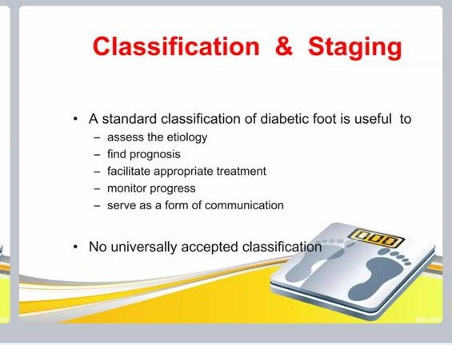

Slide 21
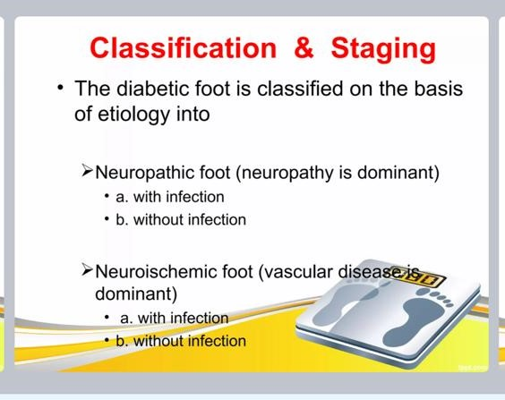

Slide 22
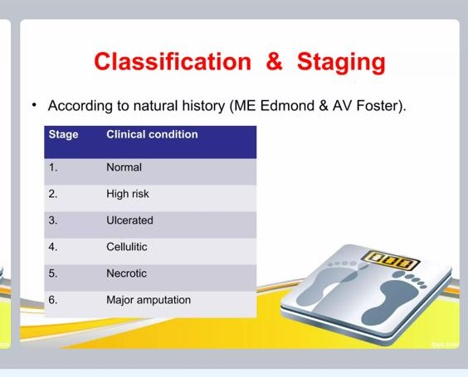

Slide 23
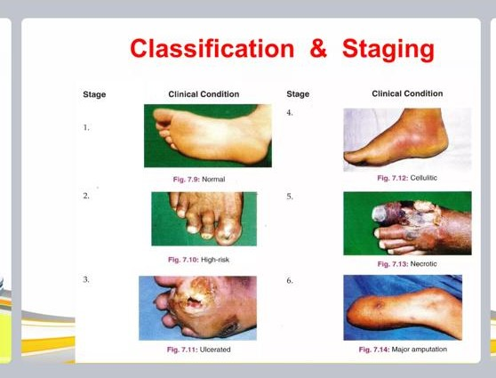

Slide 24


Slide 25
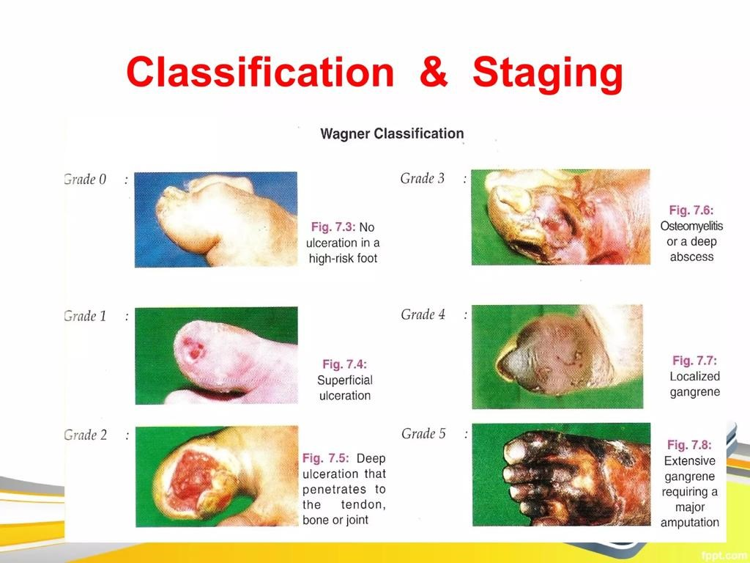

Slide 26
MANAGEMENT OF DIABETIC NEUROPATHY
The management plan for diabetic neuropathy includes:
optimized glycemic control, lifestyle interventions such as physical exercise and weight loss, and medication for neuropathic pain.
Tricyclic antidepressants, serotonin-norepinephrine reuptake inhibitors, and anticonvulsants are commonly prescribed treatments for neuropathic pain. Multidisciplinary team management is required for the prevention and management of diabetic foot complications.

Slide 27
MANAGEMENT OF DIABETIC NEUROPATHY
Strength training can moderately improve muscle function, reduce neuropathic pain, and help control blood sugar levels for people with diabetic neuropathy
A balanced diet and regular exercise are also recommended
There are currently no universally accepted disease modifying medicines, but research is ongoing

Slide 28
MANAGEMENT OF DIABETIC FOOT ULCER
The management of diabetic foot ulcers requires offloading the wound, daily saline or similar dressings to provide a moist wound environment, debridement when necessary, antibiotic therapy with or without surgical intervention if osteomyelitis or soft tissue infection is present, optimal control of blood glucose, and evaluation and correction of peripheral arterial insufficiency. To promote ulcer healing in a person with diabetes and a neuropathic plantar ulcer, consider, if nonsurgical offloading therapy is unsuccessful, Achilles tendon lengthening, metatarsal head resection(s), or joint arthroplasty.

Slide 29
MANAGEMENT OF HOSPITALISED PATIENTS
Nursing management for hospitalized patients with diabetic complications involves a comprehensive approach that focuses on the management of diabetes, as well as the specific complication that the patient is experiencing. The goal of nursing management is to prevent further complications, promote healing, and support the patient in achieving optimal health.
Monitor blood glucose levels: Nurses should monitor the patient's blood glucose levels regularly to ensure they are within the target range. This may involve administering insulin or other medications, as well as adjusting the patient's diet and activity level.

Slide 30
MANAGEMENT OF HOSPITALISED PATIENTS
Manage pain: Patients with diabetic complications may experience pain related to neuropathy, infections, or other issues. Nurses should assess the patient's pain level regularly and administer appropriate pain medications.
Provide wound care: Patients with diabetic foot ulcers or other wounds require careful wound care to prevent infection and promote healing. Nurses should clean and dress wounds according to best practices and monitor for signs of infection

Slide 31
MANAGEMENT OF HOSPITALISED PATIENTS
Educate patients on self-care: Patients with diabetic complications need to understand how to manage their condition and prevent further complications. Nurses should provide education on self-care, including proper foot care, blood glucose monitoring, and medication management.
Monitor for complications: Patients with diabetic complications are at risk for developing further complications, such as kidney disease, retinopathy, and cardiovascular disease. Nurses should monitor for signs of these complications and intervene as necessary to prevent further damage.
.

Slide 32
MANAGEMENT OF HOSPITALISED PATIENTS
Coordinate care with other healthcare providers: Patients with diabetic complications may require care from multiple healthcare providers, including endocrinologists, podiatrists, and ophthalmologists. Nurses should work closely with these providers to ensure that the patient's care is coordinated and that all aspects of their condition are being addressed.

Slide 33
REFERENCES
https://www.cdc.gov/diabetes/basics/diabetes.html.
https://www.mayoclinic.org/diseases-conditions/diabetes/symptoms-causes/syc-20371444.
https://www.who.int/news-room/fact-sheets/detail/diabetes.
https://www.mintstl.com/blog/how-to-spot-the-signs-of-a-diabetic-ulcer-on-the-foot#:~:text=A%20foot%20ulcer%20looks%20like,an%20indication%20of%20another%20problem
Diabetic Neuropathy - Physiopedia (physio-pedia.com)
Management of Diabetic Peripheral Neuropathy | Clinical Diabetes | American Diabetes Association (diabetesjournals.org)
Management of diabetic neuropathy – UpToDate
Management of diabetic neuropathy - PubMed (nih.gov)

Slide 34
THANK YOU
FOR
LISTENING

